Slide 1
Qualcomm VisionX
Challenge 2: Object Detection
~By Ninja Team

Slide 2
Abstract
This project focuses on developing an advanced object detection and tracking system capable of processing video data in real-time. By leveraging YOLOv8 (You Only Look Once version 8), the solution ensures high precision in detecting, classifying, and localizing objects while minimizing false positives and negatives. The model adapts to diverse conditions such as varying lighting, angles, and occlusions.
Integrated tracking capabilities enable the system to monitor object movement across video frames, demonstrating applications in surveillance, autonomous driving, and retail automation. The system is equipped with a user-friendly interface powered by Gradio for effortless interaction.

Slide 3
WorkFlow
Input:- The system accepts video files as Input.
Detection & Tracking:- The YOLOv8 model processes each video frame,detecting & classifying objects, while assigning unique IDs for object tracking across frames.
Annotation:- Detected objects are Annotated with bounding boxes, and tracking tragectories are visualised using polylines.
Output:- The processed video, with annotations and tracking data, is saved and displayed to the through Gradio Interface.

Slide 4
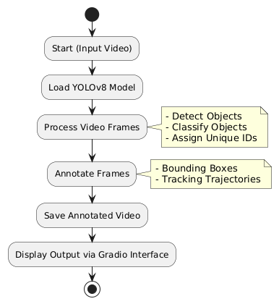
FlowChart

Slide 5
CodeFlow Explanation
Import Libraries:- Necessary libraries like ultralytics,opencv-python-headless, and gradio are imported for object detection, video processing, and interface creation.
Model Initialisation:- The YOLOv8 Model is loaded for object detection and tracking.
Video processing:- Frames are read sequentially from the input video. YOLOv8 detects objects, assigns unique IDs for tracking, extracts bounding box coordinates.
Tracking:- Object trajectories are maintained using unique IDs and tracking lines are drawn for smoother visualization.
Video annotation:- Frames are annotated with bounding boxes and tracking lines.
Output :- The Processed video is saved locally and displayed via a Gradio Interface for user interaction.

Slide 6
Summer of Key Components
YOLOv8 Model:- A lightweight, real time object detection model ensuring high precision and adaptability to diverse environments.
Tracking Systems:- Tracks objects across frames using unique IDs and visualizes their paths.
Video processing pipeline:- Efficiently handles video input,processes frames, and generates annotated output.
Gradeio Interface:- Provides an interactive web based platform for video upload, processing and result visualization.

Slide 7
Thank You

